Slide 1
Data Access Patterns
Notes:
Patterns for bridging the “impedance mismatch” between object-oriented world of an application and relational world of persistent storage.
“Essentially, the DAO acts as an adapter between the component and the data source.”
“The DAO is implemented as a stateless object. It does not cache the results of
any query execution, or any data that the client might need at a later point. This
makes the DAOs lightweight objects and avoids potential threading and concurrency issues.”
“The DAO encapsulates the details of the underlying persistence API.”
DAO may use a transfer object (eg CustomerTO or EmployeeTO) to encapsulate and return record values.
“. . . we use Transfer Object to pass data between a Data Access Object and its clients.”
“Though the Data Access Object creates a ResultSet instance when the query is executed,
it’s best to keep the ResultSet encapsulated within the Data Access Object at all
times.”
“important to avoid exposing implementation-specific data structures, such as ResultSet instances outside the data access layer.”
May have a find method that returns multiple DTO’s:
Collection<DTO> find (criteria);
If the amount of return data is potentially large, consider using a data cursor object such as RowSet (another data access pattern).
“In its most basic form, a Data Access Object provides the operations to create,
delete, update, and find data in a database. ... The Data Access Object typically exchanges data with its
clients using Transfer Objects”

Slide 2
Motivation
Most software systems require persistent data (i.e. data that persists between program executions).
In general, distributing low-level data access logic throughout a program is not a good idea (design).
Program
select * from Items
rs.getString("Name")
Data
Notes:
“Data is a major element in the foundation of any enterprise.”
“Applications need to work with multiple database products.
User interfaces need to hide obscure database semantics.
Data access details make application code difficult to develop and maintain.
Applications need to cache data that they access frequently.”
“Data access patterns describe generic strategies for solving common design problems”
“A pattern does not necessarily dictate a particular implementation. Instead, it describes an effective
design and structure that form the basis for a solution.”
Decoupling patterns: “describes patterns that decouple data access code from other
application logic, resulting in cleaner application code that is less susceptible to defects caused
by changes that relate only to data access details.”
“Nearly every enterprise application is backed by persistent data. An application's data is often worth
considerably more to its users than the application itself. The majority of many systems' resources
are dedicated to implementing and managing data access details and logistics. For this reason, it
is important to understand both your data's structure and application's interactions with it in detail
so you can tune both for efficiency and maintainability.”
“Data access code
that is spread across many components is difficult to change and optimize, let alone comprehend.
Data access code is best left encapsulated within a small number of components so that it is more
maintenance-friendly.”
“Creating enterprise software requires two distinct types of expertise. First, developers must be
intimately acquainted with the application domain. An application domain includes objects and logic
that accurately model business concepts and processes. Creating an effective business application
requires you to understand what data is involved, the relationships among the data, and what expert
users expect to do with it. It is painfully obvious when an application is not designed by domain
experts because it forces users into unnatural paradigms.
The second expertise required to develop enterprise software is the ability to write efficient and
transparent middleware. The term “middleware” refers to the plumbing between application code
and the system. Examples of middleware are system resource libraries, prefabricated graphical user
interface (GUI) components, and database drivers. In addition, you can consider any code that you
write that acts as a conduit between an application and these libraries to be middleware as well.
Writing efficient, maintainable middleware code requires extensive knowledge of database resources and libraries.
These specialties differ in a few regards. Developers with application domain expertise usually attain
their skill through industrial experience, while middleware experts learn from professional training
and documentation. It is uncommon to find programmers with both skill sets. Most middleware programmers
are not able to design a truly marketable business application. Conversely, many business application
developers do not write efficient middleware code.”
“Beginning programmers tend to tackle concrete problems with specific solutions. The resulting code
precisely addresses the immediate needs of their customers and requirements. As projects progress
and programmers gain experience, they learn how to factor common code and designs into mod-
ules.
Modules are a form of software abstraction. Software abstraction is the process of making a solution
to a specific problem useful in a broader scope. As you abstract a specific solution, you focus on
the solution's distinctive characteristics while decoupling it from other components in the system
[Booch 1994]. This concentrated focus simplifies complex solutions because it deemphasizes the
interactions with other objects. Software abstraction usually leads to more effective and reusable
designs and code. Done well, abstractions and reuse significantly reduce overall software
development and maintenance costs.”
Two levels of decoupling: decouple from DB details and decouple from middleware you write.

Slide 3
Data Access Layer
A better design is one that includes a data access layer which encapsulates the details of the underlying persistence API.
It abstracts the low-level details of persistent storage.
It provides an interface that is usually a better match for the style of programming used in the domain logic. For example, the data access layer might provide an OO interface onto relational data.
Notes:
bridging the “impedance mismatch”

Slide 4
Program
Program
customer = dao.find(id)
update(customer)
select * from Items
rs.getString("Name")
Data Access Layer
select * from Items
rs.getString("Name")
Data
Data
Notes:
encapsulates the details of the underlying persistence API

Slide 5
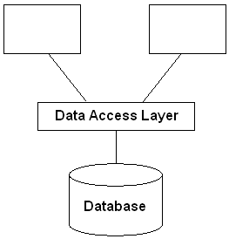
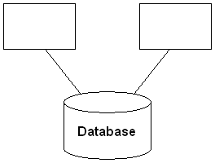
Data Access Layer
To avoid problems associated with mixing SQL and application logic, SQL statements and data base design details are often encapsulated in a data access layer
The data access layer presents an interface that is convenient for application programs.

Slide 6
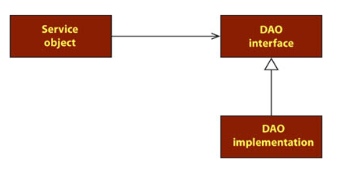
Program to an Interface; Not Implementation
Notes:
“Service objects are accessing the DAOs through interfaces.”
“Service objects don’t handle their own data access. Instead, they delegate data access to DAOs. The DAO’s interface keeps it loosely coupled to the service object.”
“interfaces are key to writing loosely coupled code and that they should be used at all layers of an application, not just at the data access layer”

Slide 7
SQL
Most software systems that need persistent storage more powerful than a flat file end up using a relational database management system
SQL is the standard language for managing data in a relational database.
Mixing SQL with application logic is considered poor design.
  Writing simple SQL statements takes a fair amount of skill, and writing efficient SQL statements takes even more. If you mix SQL and application logic, it makes it harder for those unskilled in SQL to work with the code.
  Changes to the database may necessitate changes to the SQL that accesses the database. If the SQL is spread throughout the program, a small change to the database might cause a strong ripple effect throughout the program.
Notes:
For most applications, the data access layer will encapsulate SQL logic.

Slide 8
General benefits of having a data access layer
Separation of concerns. Data storage logic is kept separate from domain logic.
Information hiding. Domain logic avoids dependencies on database schema.
Ability to change DB vendors without disrupting client code.
Notes:
Provides object-oriented view of persistent data.
Encapsulates database schemas
“A layer of DAOs makes it easier for an application to migrate to a different
database implementation. The clients have no knowledge of the underlying
data store implementation. Thus, the migration involves changes only to the
DAO layer”
“Reduces code complexity in clients
Since the DAOs encapsulate all the code necessary to interact with the persistent
storage, the clients can use the simpler API exposed by the data
access layer. This reduces the complexity of the data access client code and
improves the maintainability and development productivity.”

Slide 9
Data Access Architecture Patterns
Key architecture patterns used in the implementation of a data access layer:
  Table Data Gateway (aka Data Access Object)
  Row Data Gateway
  Active Record
Notes:
Of the three patterns, Table Data Gateway is probably the most common.
The data access architecture patterns mention here come from Patterns of Enterprise Application Architecture, Fowler.
DAO is probably a better name because it suggests an interface onto any type of persistent store, not just relational. I’ll use the term Table Data Gateway because it is more consistent with other two patterns discussed.

Slide 10
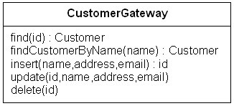
Table Data Gateway
Put all the logic for managing
the records of a table into one
class.
There is one instance of the
class for each table/view.
find() methods return data for one row of the table/view.
insert(), update() and delete() modify one row.
Stateless (unlike Row Data Gateway)
A Data Transfer Object (DTO) may be used to encapsulate and return record values.
Customer in the class diagram to the right is an example of a DTO.
Notes:
Most popular.

Slide 11
Table Data Gateway Variations
Customer might include
an id field. This would
simplify certain routines:
update(Customer)
There may be find methods that return more than one record. One option for implementing such methods is to return a collection of DTO’s:
List<Customer> find(criteria)
Notes:
A collection class such as ArrayList or Vector may be used to return multiple results.
TBD: change class diagram above. Modify update field to accept Customer. Example: update(Customer c). Add findAll() method.

Slide 12
Design Decisions/Discussion
find() methods can return:
  Record set (data structure from SQL query such as ResultSet). Convenient if find returns multiple records.
  Data Transfer Object (object with getters and setters used to pass data around)
  Generic collection class (e.g. map which may contain instances of a DTO)
If table/view is read only, there is no need for insert, update and delete.
Notes:
Returning instances of the ResultSet of the underlying database would be an efficient method of returning multiple records it is not recommended because it exposes implementation details to clients.

Slide 13
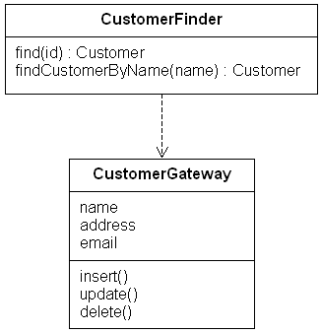
Row Data Gateway
Define a stateful class
that encapsulates the
data for one record of
your data source.
There is one instance
per row.
The logic to find a record
(one instance of the row
data gateway class) can be
represented as static methods on the row data gateway class or encapsulated in a separate finder class.
Notes:
If you don’t need to find multiple records from the same table and/or will be working with individual records from multiple tables and don’t want to declare a separate DTO, consider using a Row Data Gateway.
Row data gateway could be a gateway on a database view (ie > 1 table).
“set and get methods to access and modify the in-memory data structure, and update, insert, and delete methods to execute the appropriate SQL for the action and data against the database.”

Slide 14
Usage scenarios
Use finder object to fetch one row (an instance of row data gateway). Make updates to instance (it’s stateful). Ask instance to update().
Create an instance of row data gateway. Ask instance to insert().
Notes:
“update and deletion actions may not be available when a table data gateway corresponds to a view.”

Slide 15
When to use each pattern?
Table Data Gateway is probably the simplest of all three. It also works well when you want to (or it’s not an inconvenience to) use record sets from SQL query.
Row Data Gateway is convenient when you need data from two or more records in memory at once and it’s inconvenient to store the data in another data object (inconvenient = don’t want to create another object).
Row Data Gateway also factors out the find/access logic. This is useful if it needs to be reused or can vary.
Notes:
Consideration when trying to decide between Table Data Gateway and Row Data Gateway: Row Data Gateway doesn’t handle collections of objects.
“TABLE DATA GATEWAY is most useful if database records are accessed, modiﬁed, and stored in sets, rather than individually”
One drawback of table data gateway compared to row data gateway: “Signiﬁcant changes to the schema that change the normalization of rows and partitioning of tables, however, are not as well supported.”

Slide 16
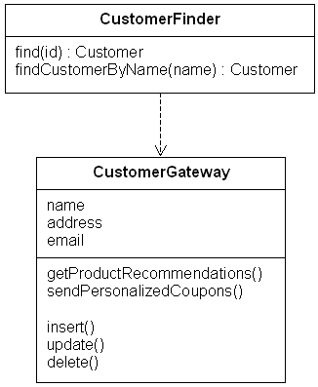
Active Record
Active Record is a Row Data Gateway class with domain logic.
Notes:
Don’t want/need a separate domain logic layer between your view layer and data access layer? Consider using an Active Record. Active record allows simple domain logic to be included in object which encapsulates DB access logic.
Applicable when domain model closely match the structure of the underlying database. This pattern doesn’t work well if the objects in the solution domain don’t line up well with tables in the database.
“For data structures with only simple associated behaviors, a multi-layered solution may be too complex”
“ACTIVE RECORD can be an appropriate choice when the domain logic of an application is relatively simple”
“The implementation can suffer, however, if it mixes problem domain concepts with infrastructural concepts,
which results in tight coupling between application and database parts.”

Slide 17
References
Patterns of Enterprise Application Architecture
Data Access Patterns: Database Interactions in Object-Oriented Applications
Pattern-Oriented Software Architecture: A Pattern Language for Distributed Computing, 4th Volume
Agile Principles, Patterns, and Practices in C#
Core J2EE™ Patterns: Best Practices and Design Strategies

Slide 18
Android

Slide 19
Persistent Storage in Android
Options:
  Shared Preferences
  Internal Storage – local to application
  External Storage – shared space
  SQLLite Database
  Network Resources
Notes:
Good reference: http://developer.android.com/guide/topics/data/data-storage.html
TBD, if you override view you will need to save data on screen orientation switches. (See page 124 of Hello Android. It shows how to save instance state of a view.)

Slide 20
Shared Preferences
PreferenceActivity – standard way of saving settings
getSharedPreferences() –
  Example: SharedPreferences preferences = getSharedPreferences(PREF_FILE_NAME, MODE_PRIVATE);
getPreference - uses the getSharedPreferences() method with the name of the activity class for the preference file name
getDefaultSharedPreferences – similar to getPreference() but uses a default file name.
Limited to boolean, float, long and String.
Notes:
MODE_PRIVATE is the operating mode for the preferences. It is the default mode and means the created file will be accessed by only the calling application. Other two mode supported are MODE_WORLD_READABLE and MODE_WORLD_WRITEABLE. In MODE_WORLD_READABLE other application can read the created file but can not modify it. In case of MODE_WORLD_WRITEABLE other applications also have write permissions for the created file.

Slide 21
Internal Storage
openFileInput()
openFileOutput()
deleteFile()
fileList()
Notes:
All methods on Context (eg Activity)

